Slide 1

Final Year Project Report
GROUP-17
Integrating BCI and Machine Learning for Enhanced Robotic Arm Control
Project Supervisor: Dr. Jehangir Arshad
Project Co-Supervisor: Ms. Wajeeha Khan
Team Members
M. Yousaf Iqbal FA20-BCE-008​
Moiz Usman FA20-BCE-025​
Fazeel Abbas FA20-BCE-041​
M. Naeem FA20-BCE-093

Slide 2
Presentation Outline
Introduction
Objectives
Problem Statement
Literature Review
Methodology Flow Diagram
EEGLAB for pre-processing
Explaining Data Set
Classification Algorithms
Robotic Arm
Conclusion & Limitations
Future Studies

Slide 3
Introduction
In this project Robotic Arm is controlled by using ML and BCI
BCI System is used to control external devices using Brain Signals
Data set was acquired by using Emotive 14-channel headset.
These raw signals are noisy. therefore, It is necessary to Amplify these signals and Remove Noise.
For Pre-Processing EEGLAB From MATLAB is used for down-sampling removing artifacts and acquiring alpha and beta frequency signals.
After Filtering Feature Extraction and Feature Classification Techniques are used. Python was used to add features such as STD, Mean, And Power of each electrode.
Microcontroller Arduino UNO is used to move a robotic arm.
This advancement can significantly improve the quality of life for individuals with limb loss, granting greater independence in daily tasks.

Slide 4
Objectives
The objectives of this project are as follows
Extraction of data through an EEG headset.
To clean and de-noise the input data for feature extraction.
Implementation of Machine Learning models to classify the EEG signals into different
Robotic arm control instructions.
To design a robotic arm and control it using Arduino Uno and Python.

Slide 5
Problem Statement
The project strives to bridge the gap between humans and robots, providing mobility and independence to physically challenged individuals. It also holds promise for diverse applications, including healthcare and Virtual Realities. This advancement has the potential to significantly enhance the independence, mobility, and overall well-being of individuals with conditions such as strokes, spinal cord injuries, cerebral palsy, and ALS, marking a significant step toward empowerment in the realm of assistive technologies.

Slide 6
Literature Review
Ref # | Methodology | Results
[19] | Explains the different applications of BCI and its techniques including EEG, ECOG, and MEG. | EEG techniques is used since it’s noninvasive.
[28] | The brain waves that have several classes such as delta, theta, alpha, beta and gamma waves. | Studies shows that the alpha and beta waves are present them moving arm.
[29-35] | The Techniques explained for data filtering are FFT, DFT, Inverse DFT. Digital filters such as FIR, IIR filers CWT and DWT. | FIR filters are more preferable when it comes to pre-processing the brain signals.
Ref # | Methodology | Results
[39-42] | Some techniques for removal of eye artifacts are (PCA) and (ICA). | ICA is used to from eye artifacts.
[6,43-45] | The classification can be divided into linear classifiers, neural networks, nonlinear Bayesian classifiers nearest neighbour classifiers and algorithms using combinations of classifiers. | The accuracy for Random is 70%, for K-NN is 65%, Gradient Boosting is around 60%.

Slide 7
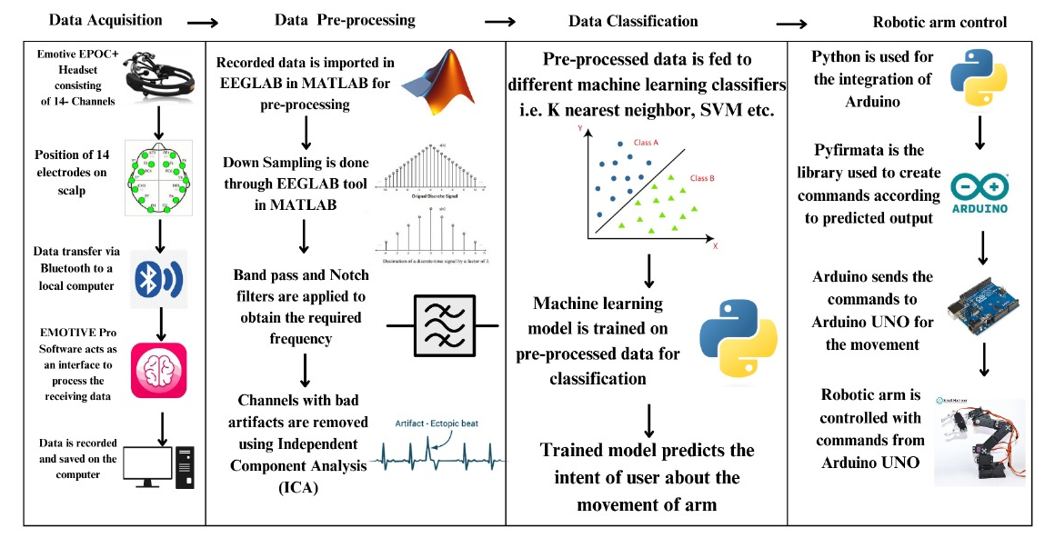
Methodology Flow Diagram

Slide 8
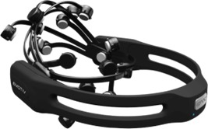
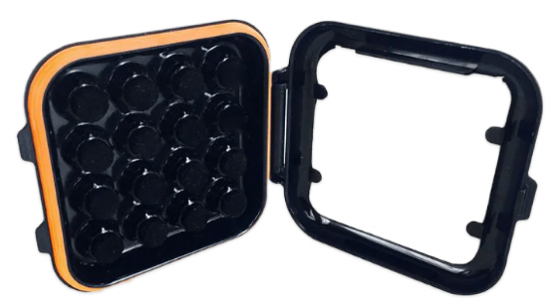
Emotive Headset and Electrodes
Emotive EPOC+ 14 channel Headset is used for data Acquisition. EEG headset was connected to the system using Bluetooth and emotive PRO was used to check the EEG Signal quality and to share data.
These are the 14 electrode channels numbered AF3, F7, FC5, T7, P7, O1, O2, P8, T8, FC9, F4, F8, and AF4 with a sampling frequency of 128 Hz and a 16-bit analog to digital converter was used.

Slide 9
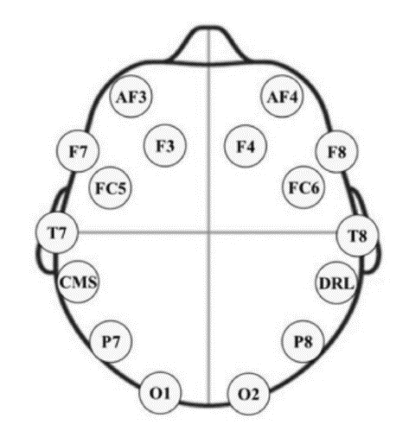
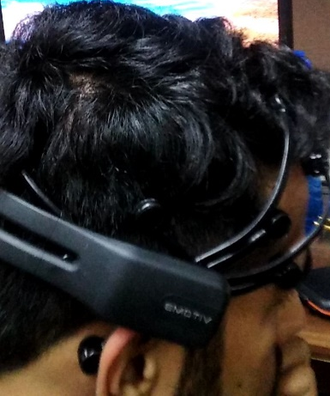
Channel location for data Acquisition
The below figures shows the placement of electrodes on the head.
For Data Acquisition motor imagery is used. Durations are set to easily separate segments and to map them to robotic arm movements.
Motor imagery | Robotic arm movement | DURATION
Left Arrow | Dataset recorded to move robotic arm in left direction | 30 seconds
Right Arrow | Dataset recorded to move robotic arm in right direction | 30 seconds
Rest | No motors will be working | 30 seconds

Slide 10
EEGLAB for pre-processing
EEGLAB by MATLAB is used to pre-process the data for feature selection and classification.
Filtering Techniques used are Clean line filter, Down-sampling, and Notch filter are used.
Clean-line filter is EEGLAB built-in filter used to remove the DC offset of the signals.
Down-sampling helps minimize the use of resources.
FIR filter is used to get the required frequency range which is 8hz to 32hz
ICA ( Independent component analysis) is used to remove eye Artifacts.

Slide 11
Explaining Data Set
Dataset was created for 3 users. We used motor imagery to acquire data. Data was obtained for 30 seconds and after that only data from 10 seconds where user focus was best selected for further processing.
Dataset contains 3 classes 0 for left, 1 for right, and 2 for no movement.
Python was used for feature engineering. STD, Mean, and power of each electrode were added as features.
This updated dataset was used for training algorithms.
80 % of the data is used to train the model and 20 % of the remaining data was used to test the accuracy of different classifiers.

Slide 12
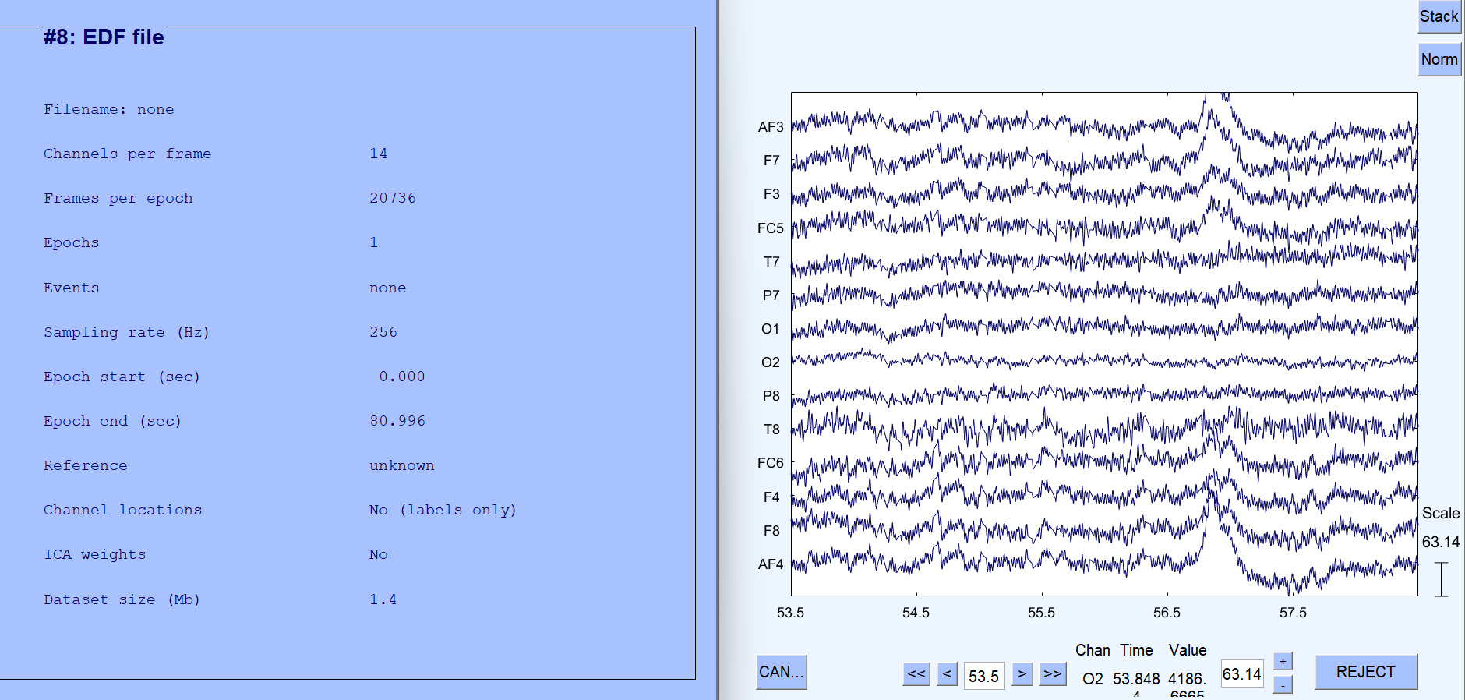
Initial Signals
Here the signal-to-noise ratio is very bad. There are many artifacts present in the data. There are some channels we don’t really need, and DC offset is also present in the signals.

Slide 13
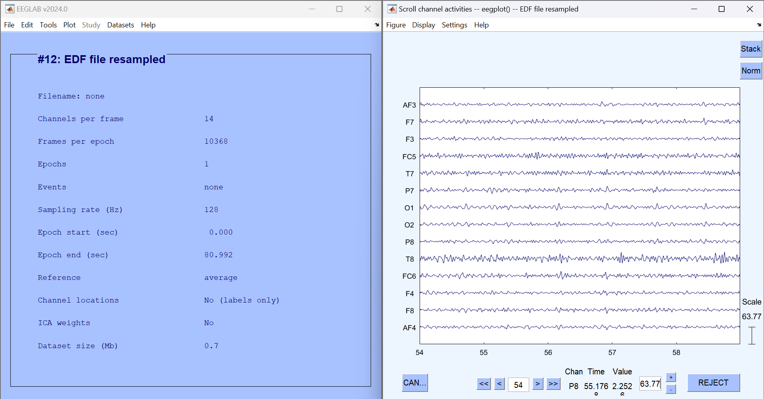
Filtering
After removal of DC offset and down-sampling FIR(Finite Impulse response) filter is used as a band pass filter to remove big spikes in the data and lower the amplitude on eye artifacts.

Slide 14
Classification Algorithms
The classifiers are used in this project.
Random Forest Classifier
Decision Tree Classifier
Gradient Boosting Classifier
K-Nearest Neighbor Classifier
Naïve Bayes Classifier
Logistic Regression
Random Tree Classifier gives the highest accuracy because it prevents overfitting.

Slide 15
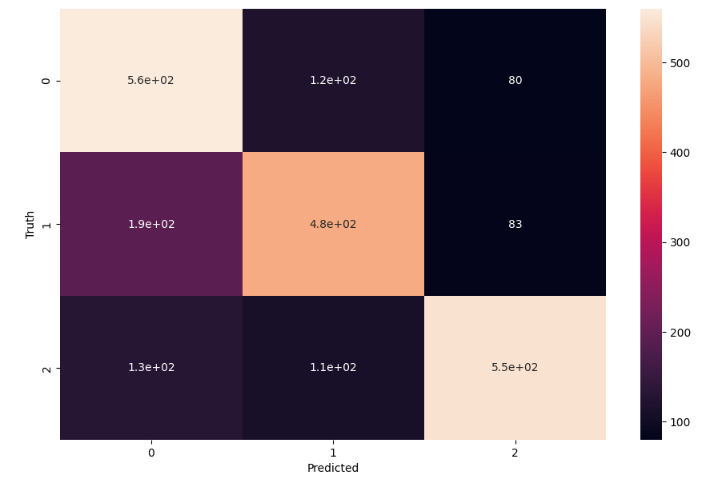
Random Forest Classifier
We have obtained 70% accuracy from random forest classifier
Confusion Matrix:

Slide 16
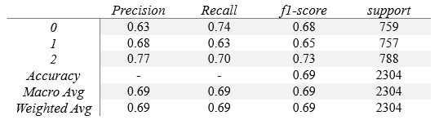
The overall accuracy across the three classes is 69%. Class 2 is the best predicted, with a precision of 77%. Class 0 also performs with 63% accuracy and 74% recall. Class 1, however, shows lower performance with a precision of 68% and a recall of 63%.
Classification Metrics

Slide 17
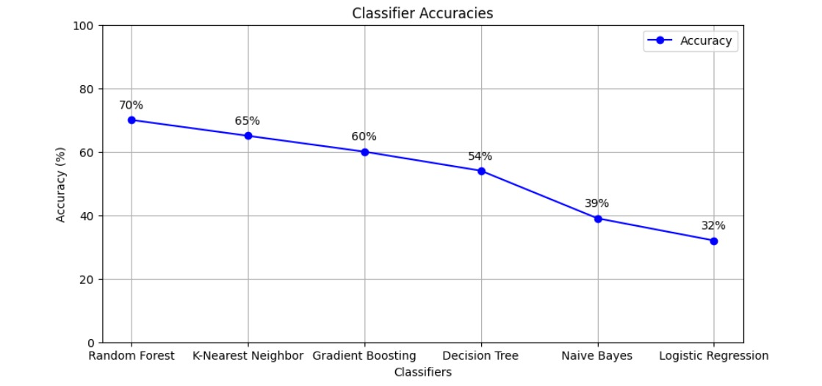
Comparative Analysis of Classifier Accuracies
The comparative analysis shows that the accuracy for Random Forest remained optimal at 70%, K-nearest neighbor is around 65%, Gradient Boosting is around 60%, Decision Tree is around 54%, Naïve Bayes is around 39%, while the lowest is 32% for Logistic Regression.
The previous studies used Decision tree, Naïve Bayes and Logistic Regression with 64%, 60% and 52% accuracies respectively. In this project, Random Forest, KNN and Gradient Boosting were used with 70%, 65%, and 60% accuracies respectively which is a better approach.

Slide 18
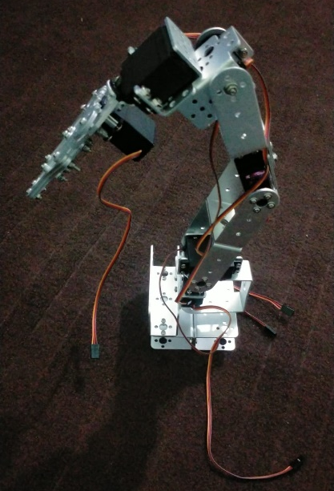
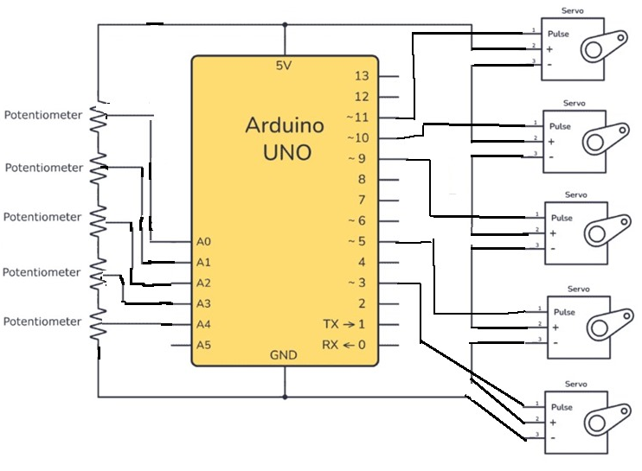
Robotic Arm
A robotic arm with five degrees of freedom (5-DOF) means that arm can move in three dimensions in a number of independent ways.
Waist Rotation (Joint 1): Rotation around a vertical axis at the base.
Shoulder Rotation (Joint 2): Vertical movement, lifting or lowering the arm.
Elbow Rotation (Joint 3): Pivot movement of the forearm.
Wrist Rotation (Joint 4): Tilting the wrist up or down.
Wrist Gripper (Joint 5): Rotation of the wrist around its own axis.

Slide 19
Conclusion & Limitations
Conclusion
Applied machine learning methods to manipulate the motion of a robotic arm with the help of information received from EEG electrodes and EEG signals.
The dataset was pre-processed using Matlab and ICA was used to remove eye artifacts.
The features such as STD, Mean, and Power were added to the dataset and three users have been chosen to implement classification algorithms.
The classifiers used in this project are Random Forest Classifier, Decision Tree Classifier, Gradient Boosting Classifier, K-Nearest Neighbor Classifier, Naïve Bayes Classifier, and Logistic Regression.
Limitations
The components such as electrodes and headset are expensive.
Software to implement this in real time isn’t available.

Slide 20
Future Studies
Future research should work to design more affordable and simplified EEG systems via miniaturization and wireless technology with low channel digital EEG frontend, to improve their application into everyday technology.
Real-time bio-signal processing and artifact reduction, feature extraction using temporally separated information while ensuring inter-subject variability for EEG interpretation without the need of frequent calibrations are required.

Slide 21
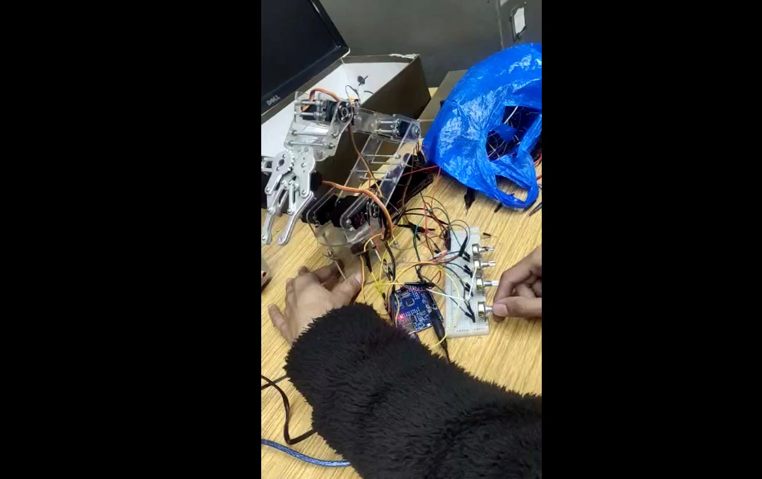

Slide 22
References
A. E. Hassanien and A. T. Azar, Eds., Brain-computer interfaces: Current trends and applications. Cham: Springer International Publishing, 2015.
R. J. Rak, M. Kołodziej, and A. Majkowski, “Brain-computer interface as measurement and control system the review paper,” Metrology and Measurement Systems, vol. 19, no. 3, 2012.
S. Sanei and J. A. Chambers, EEG Signal Processing: Sanei/EEG signal processing. Hoboken, NJ: Wiley-Blackwell, 2007.
S. Das, D. Tripathy, and J. L. Raheja, Real-time BCI system design to control arduino based speed controllable robot using EEG, 1st ed. Singapore, Singapore: Springer, 2018.
K. Nakayama, Y. Kaneda, and A. Hirano, “A brain computer interface based on FFT and multilayer neural network-feature extraction and generalization,” in International Symposium on Intelligent Signal Processing and Communication Systems, New York: IEEE, 2007, pp. 826–829.
J. Arshad et al., “Intelligent control of robotic arm using brain Computer Interface and Artificial Intelligence,” Appl. Sci. (Basel), vol. 12, no. 21, p. 10813, 2022.
D. R. Edla, K. Mangalorekar, G. Dhavalikar, and S. Dodia, “Classification of EEG data for human mental state analysis using Random Forest Classifier,” Procedia Comput. Sci., vol. 132, pp. 1523–1532, 2018.
M. R. N. Kousarrizi, A. A. Ghanbari, M. Teshnehlab, M. A. Shorehdeli, and A. Gharaviri,
“Feature extraction and classification of EEG signals using wavelet transform, SVM and artificial neural networks for brain computer interfaces,” in 2009 International Joint Conference on Bioinformatics, Systems Biology and Intelligent Computing, 2009.
Ö. Kasim and M. Tosun, “Effective removal of eye-blink artifacts in EEG signals with semantic segmentation,” Signal Image Video Process., vol. 16, no. 5, pp. 1289–1295, 2022.
Z. Lasefr, K. Elleithy, R. R. Reddy, E. Abdelfattah, and M. Faezipour, “An epileptic seizure detection technique using EEG signals with mobile application development,” Appl. Sci. (Basel), vol. 13, no. 17, p. 9571, 2023.

Slide 23
SDG Mapping
SDG 3 (Good Health and Well-being) :
This project contributes to SDG goals by using EEG signals to empower individuals with physical challenges, enabling them to control a robotic arm, fostering independence, and offering new possibilities for enhanced mobility.
SDG 9 (Industry, Innovation and Infrastructure):
By exploring new technologies in EEG signals in controlling robotic arm, this project contributes to the technology advancement and innovation.
SDG 10 (Reduced Inequalities):
People with physical disabilities often face barriers in participating in various activities. Robotic arm controlled with brain signals provide equal opportunities to the people with physical disabilities thus creating a equitable society and reduce inequalities.

